Slide 1
What I changed
Before:
Gain parameter that is unrestricted. 1 parameter for both channels
d parameter for each channel. Restricted by sigmoid to vary from -1 to 1.
After:
Removed gain parameter altogether
d now replaces the gain parameter. Removed sigmoid transform so d is unrestricted.

Slide 2
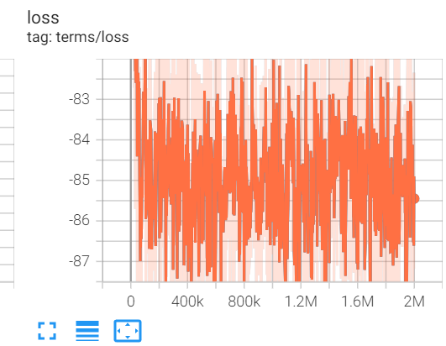
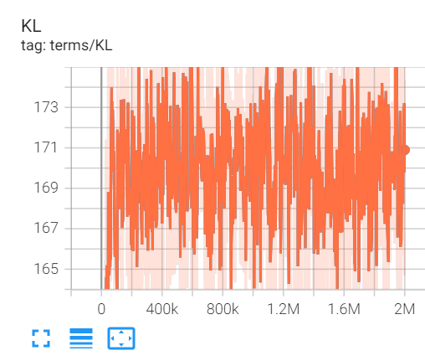
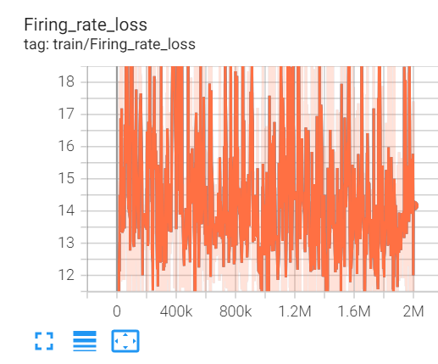
Before: Loss statistics

Slide 3
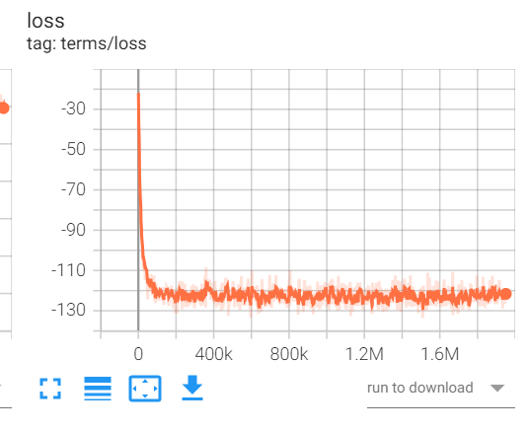
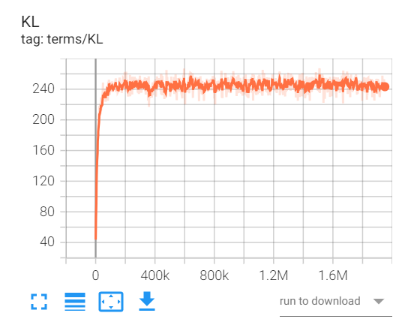
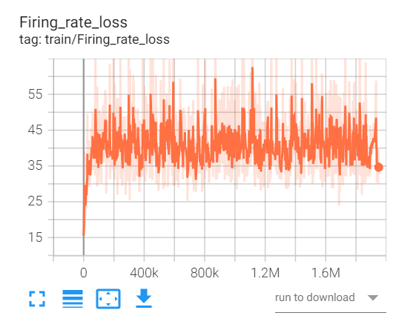
After: Loss statistics

Slide 4
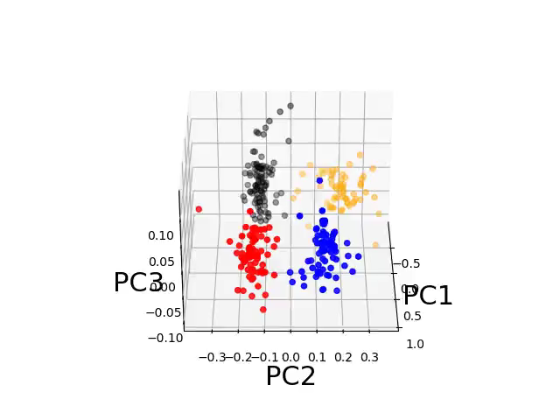
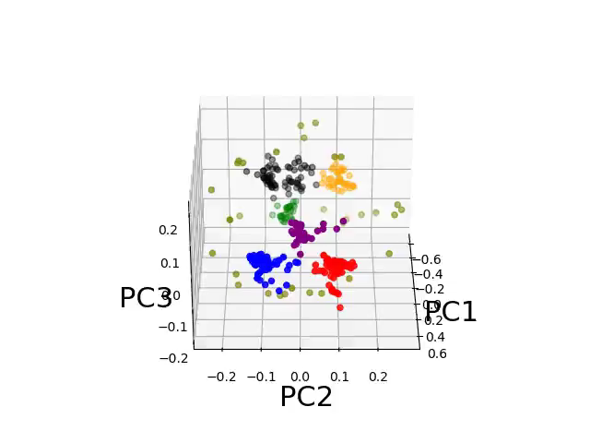

Slide 5
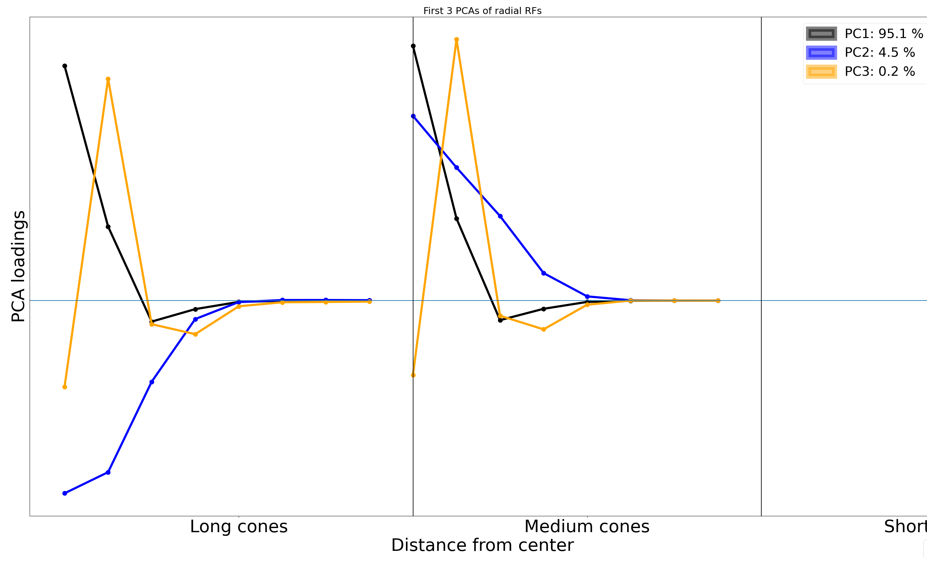
v vectors of first 3 PCs: Before

Slide 6
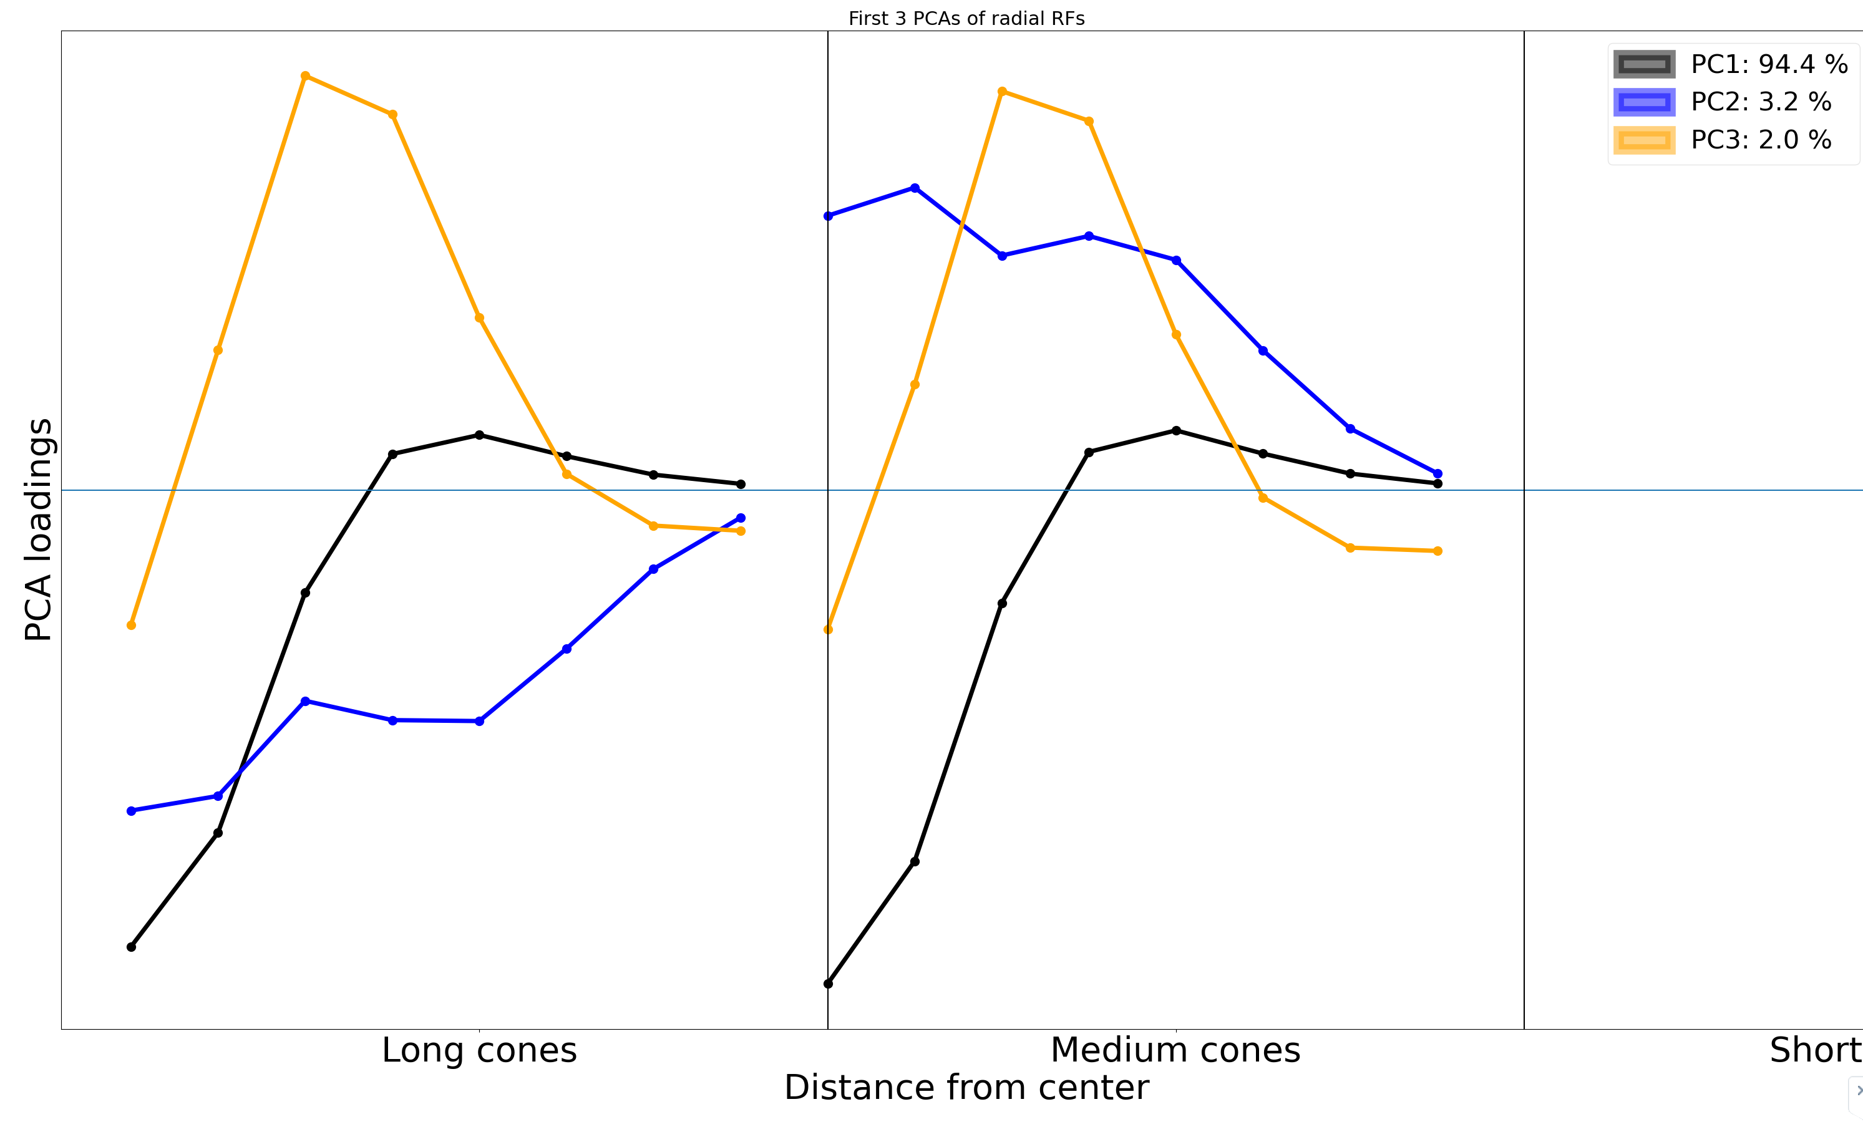
v vectors of first 3 PCs: After

Slide 7
Mosaics
Before: file:///C:/Users/David/AppData/Local/Temp/tmpnbvty48u.html
After: file:///C:/Users/David/AppData/Local/Temp/tmp1obbewkx.html

Slide 8
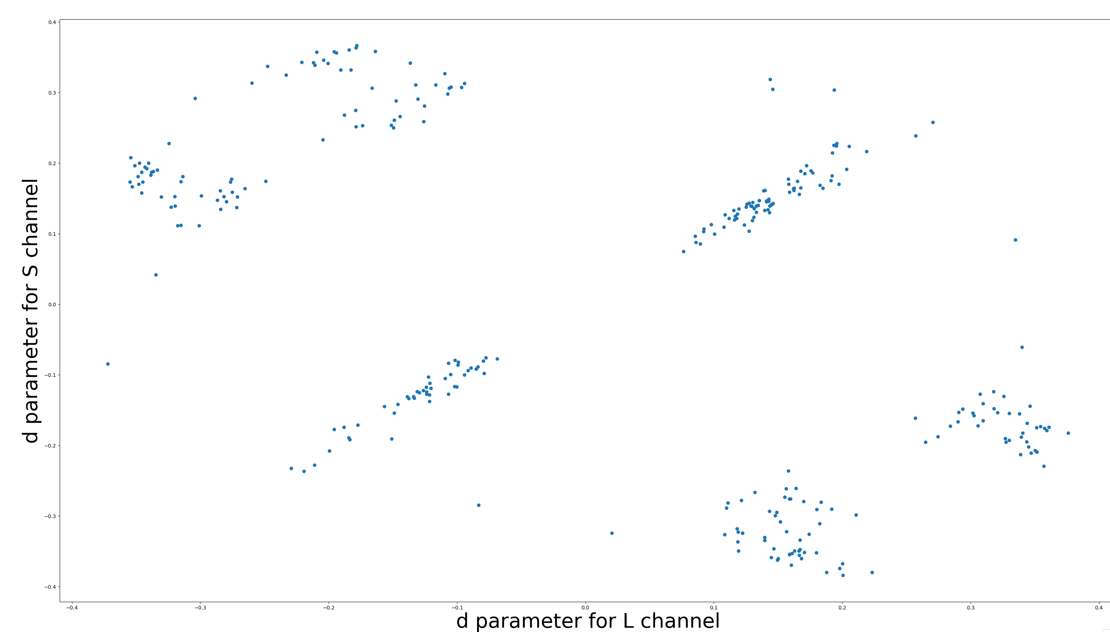
Potential bug: d parameter suggests there is a lot more color opponency than we see in radial RFs.

Slide 9
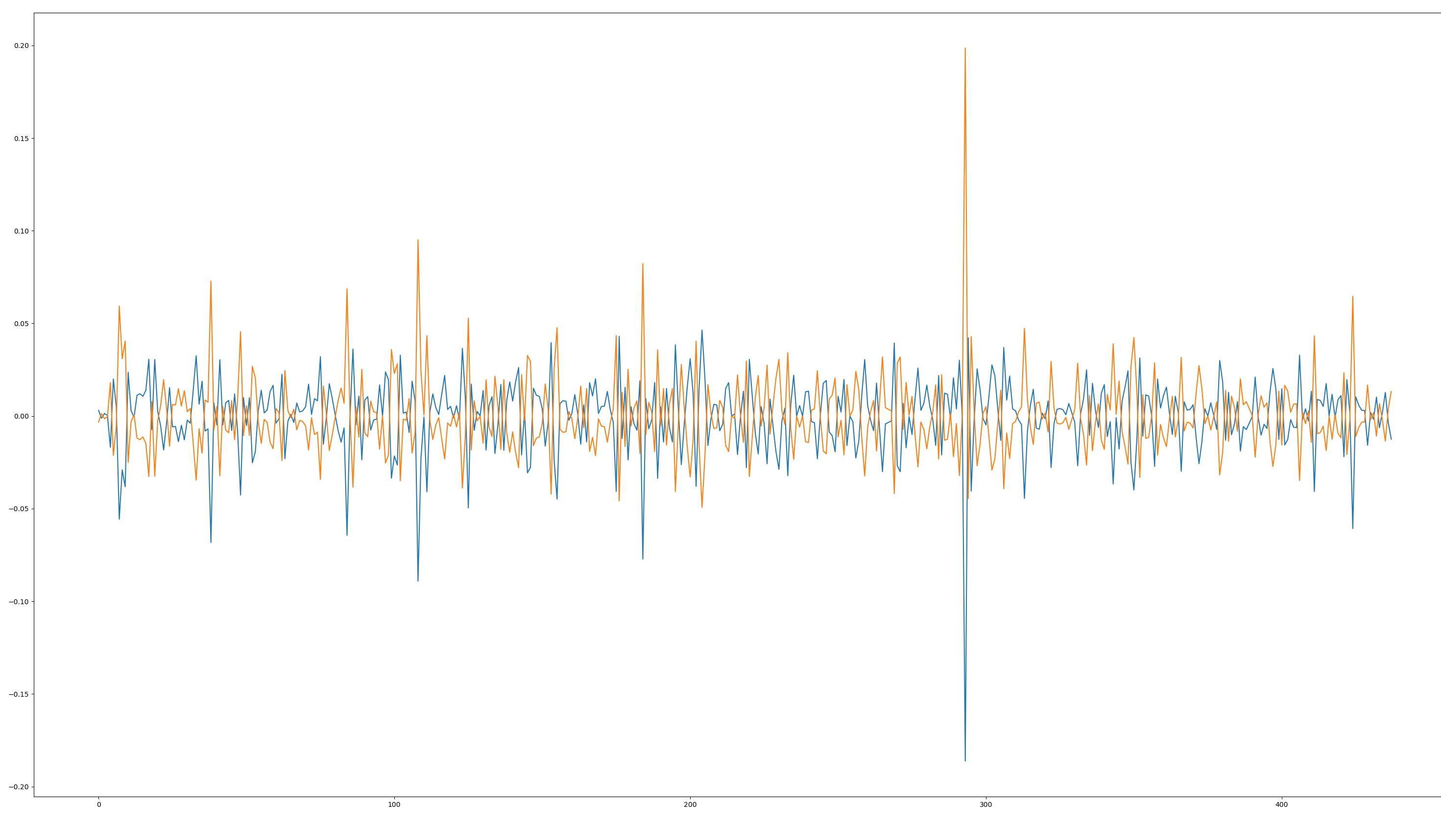
Gradient of d parameter for each channel are still opponent after convergence

Slide 10
Adding new fake channel
file:///C:/Users/David/AppData/Local/Temp/tmp_wgxshgs.html

